Slide 1

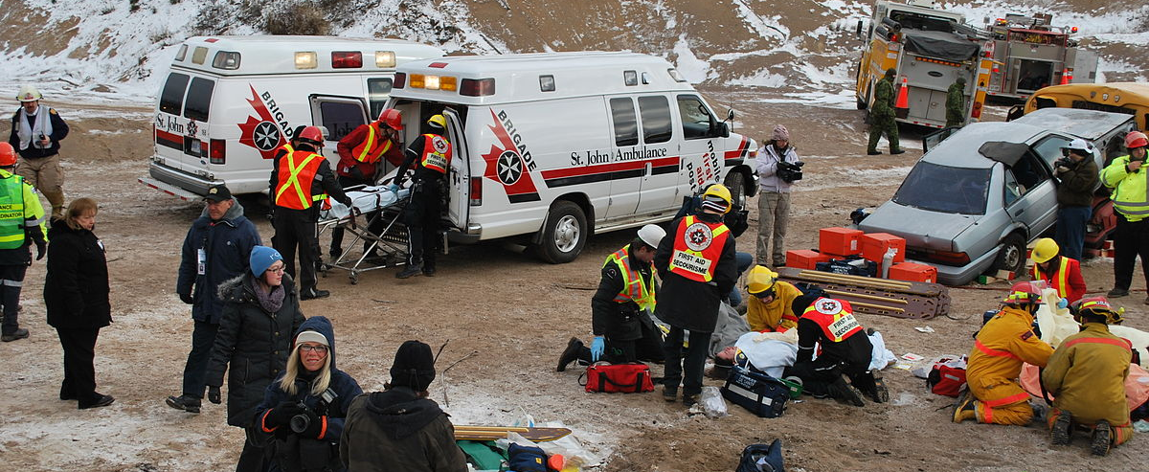
Classifying Disaster Tweets
NEIL SONALKAR
This Photo by Unknown Author is licensed under CC BY-SA

Slide 2
OVERVIEW
Classifying Tweets as Disaster or Non Disaster Tweets
Increase awareness of disasters
Will help first responders react quicker to disaster events.

Slide 3

OVERVIEW OF STEPS
This Photo by Unknown Author is licensed under CC BY-SA-NC

Slide 4
1. GETTING DATA
The data was obtained from a Kaggle Competition.
The data was in the form of a .csv file

Slide 5
2. CLEAN, MANIPULATE, and PREPARE DATA
The cleaning process for text data is different from cleaning numerical data columns.
Cleaning Involved:
Remove Punctuation
Lower case words
Remove website links
Remove numbers
Remove Stopwords

Slide 6
2. CLEAN, MANIPULATE, and PREPARE DATA(CONT.)
Once the text is cleaned, there are 3 steps taken in order to get it ready for data analysis.
1) Tokenize the text in order to separate into individual words
2) Stem/Lemmatize each tokenized word into root form (e.g. “Caring” -> “Care”)
3) Vectorize words as a TFIDF model which creates a sparse matrix of 1’s and 0’s depending on if a word occurs in a tweet or not

Slide 7
Exploratory Data Analysis
Disaster Tweet WordCloud
Non-Disaster Tweet WordCloud

Slide 8

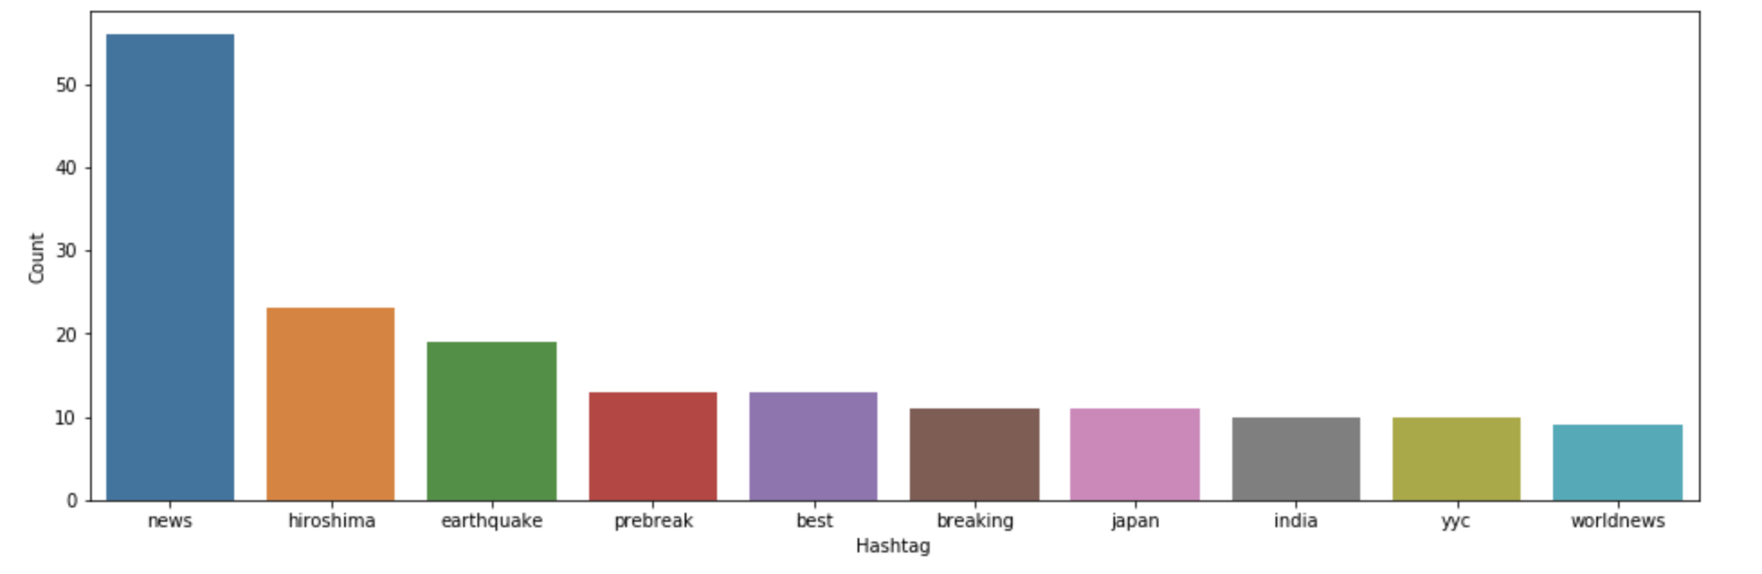



Words following Hashtag
These are the 10 most frequent words following hashtags in disaster tweets

Slide 9
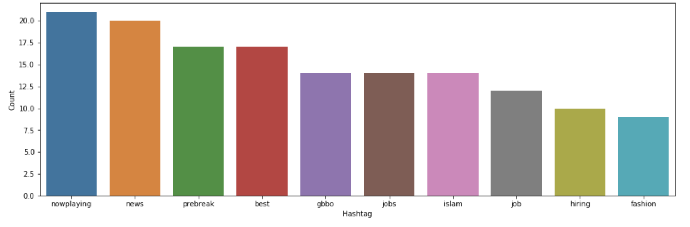
Words following Hashtag
These are the 10 most frequent words following hashtags in NON disaster tweets

Slide 10
Data Analysis
Train data
Test data
Learning algorithms
Train on 70% of the vectorized model
Test on remaining 30% by transforming the data to fit on the vectorizer
LinearSVC
Naïve Bayes Classifier
Logistic Regression

Slide 11
Model Evaluation Metrics
LinearSVC
Naïve Bayes
Improved Logistic Regression

Slide 12
RECOMMENDATIONS AND FUTURE WORK
Team up with software developers to push into production an app that is based on the work done on this project
Create more features, based on Sentiment Analysis, Entity recognition, and/or creating a stacked model approach

